Slide 1
Management data warehouse and data collector
Ian Lanham

Slide 2
Agenda
Introduction to the Data Collector and the Management Data Warehouse (MDW)
Configuring MDW and Data Collector sets (Demo 1)
Using the MDW reports (Demo 2)
Troubleshooting Issues
Q & A

Slide 3

About me
Working with SQL Server for 5 years
Database Administrator with background in Windows Servers
E-mail: ilanham@gmail.com
First introduced to SQL Saturday 5 years ago with

Slide 4
What is the management data warehouse
A combination of:
- Database tables
- Data Collector sets
- SSIS Packages
- SQL Agent jobs

Slide 5

History and Requirements
Available in all editions except Express and below
A feature introduced with SQL Server 2008….

Slide 6
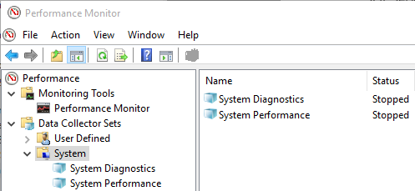
History and requirements
….except it also came out in Windows Vista
Data Collector can capture more than SQL Server metrics with customization Currently no GUI method to add custom collector sets

Slide 7
caveats
Average growth of data collector sets is roughly 600 MB per instance, per day
Source
“Who is afraid of the Data Collector? (Part 1)” by Andy McDermid
http://www.datavail.com/category-blog/afraid-data-collector-part-1/

Slide 8
caveats
Suggestion: If at all possible, put your MDW install on it’s own instance
If you find you need to remove the MDW, attempting to delete Data Collector sets and stored procedures may not work
Source “Removing the SQL Server Management Data Warehouse” by Aaron Bertrand
https://www.mssqltips.com/sqlservertip/2473/removing-the-sql-server-management-data-warehouse/

Slide 9
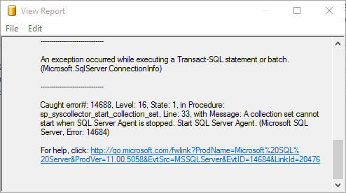
Demo 1
Enabling Data Collector and MDW
Make sure SQL Agent is enabled

Slide 10
Demo 1
Cached: Collection and upload are on different schedules, typically so collection can happen more frequently than upload
Non-cached: Collection and upload run on the same schedule. They start, collect data, and upload data into the warehouse in one shot

Slide 11
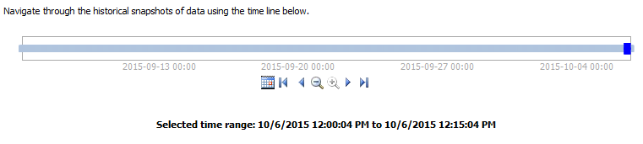
Report Controls
Before we dive in to the reports, take a look at the controls:
We can view the reports for the data in the following increments:
15 minutes, 1 hour, 4 hours, 12 hours, or 1 day
The Calendar button will allow you to change the starting date and time interval

Slide 12
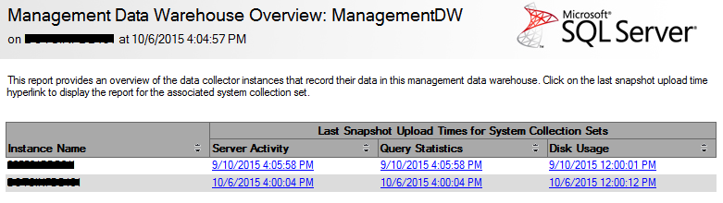
Reports
All reports have click-through actions to additional reports in different charts
Management Data Warehouse Overview
This is the point-of-entry to the other reports
Will show multiple instances if configured
Will also show last collection set upload time

Slide 13
reports
Server Activity
Captures CPU, Memory, Disk I/O, and Network Usage data (just like Performance Monitor in Windows)
Graphs will contracts between Server (total OS) usage and SQL Server usage of those 4 categories
LOTS of click-through reports here

Slide 14
Reports
Query Statistics
Captures query execution statistics and query plans for the top 10 costliest queries for the report time period selected
Can sort on CPU, Duration, Total I/O, Physical Reads, and Logical Writes
This report also has LOTS of click-through reports

Slide 15
Reports
Disk Usage
Will show disk growth a trend of disk growth for data and log files per database
Much less click-through reports than the last two

Slide 16
Reports outside of management studio
Reports are built-in to Management Studio, and by default cannot be run outside of SSMS
Bill Ramos (former Program Manager, SQL Server Manageability Team) explains: 1 - Why it’s difficult to decouple the reports from the Management Studio code, and 2 - Provides RDL files to run the reports from Reporting Services
MDW Overview Report for Data Collector – MDW Report Series Part 1
MDW Reports–New Source Code ZIP File Available

Slide 17
troubleshooting
1 - Data Collector Sets are “stuck”
How to discover?
Check the cache folder for the data collector set
2 – Agent job failed for a Data Collector Set
How to tell which Data Collector Set?
Check msdb.dbo.syscollector_collection_sets

Slide 18
troubleshooting
3 - “A data source instance has not been supplied for the data source ‘Snapshot Time’.”
Not observed on queries from system databases

Slide 19
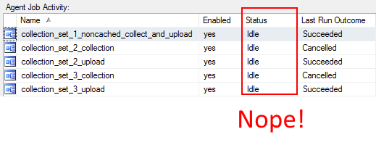
troubleshooting
4 - Still have empty collection set data?
Check the agent jobs for your cached collection sets
They need be running constantly

Slide 20
References
Data Collection (Books Online)
https://technet.microsoft.com/en-us/library/bb677179%28v=sql.105%29.aspx
SQL Server 2008 Management Data Warehouse TechNet Community Article by Kalen Delaney
https://technet.microsoft.com/en-us/library/dd939169%28v=sql.100%29.aspx
MSDN Blogs – Bill Ramos
http://blogs.msdn.com/b/billramo/

